Slide 1
Effective Document Preparation and Formation Process In Pennsylvania
Neil M. Hilkert, Esquire
Reidenbach & Associations, LLC
www.reidenbachlaw.com
neil@reidenbachlaw.com

Slide 2
ACKNOWLEDGMENTS
The following members of the firm of Reidenbach & Associates, LLC provided valuable input into the creation of the program materials for the Seminar:
THE REIDENBACH TEAM
Scott Reidenbach, Esq.,
Darin J. Steinberg, Esq.,
Rob A. Shulman, Esq.,
Megan E. Hanley, Esq.,
Nicole R. Howard, Paralegal
Reidenbach & Associates, LLC
www.reidenbachlaw.com

Slide 3
Common Interest Community Data
Estimated number of U.S. association-governed communities and individual housing units and residents within those communities in 2011
Communities: 314,200
Housing Units: 25.1 million
Residents: 62.3 million
Planned Communities: 52-55%
Condominiums: 38-42%
Cooperatives: 5-7%

Slide 4
Zoning and Subdivision Regulations
Land Development - The improvement of one lot or two or more contiguous lots, tracts or parcels of land.
Subdivision - The division or redivision of a lot, tract or parcel of land by any means into two or more lots, tracts, parcels or other divisions of land.
Municipal approval - Necessary for Common Interest Developments…
New Construction
Vacant Land
Existing Developments
See § 5106 of the UPCA and §3106 of the UCA; and
Frank N. Shaffer Family Limited Partnership v. Zoning Hearing Board of Chanceford Township, 964 A.2d 23 (Commw. Ct. 2009), aff’d, 989 A.2d 5 (Pa. 2010).
Reidenbach & Associates, LLC

Slide 5
Plats and Plans
A. For the most part the requirements for plats and plans under the UPCA are the same as the UCA.
B. Plats and Plans are part of the Declaration although not required to be part of the public offering statement. Plats and plans should be made available for inspection by purchasers during normal business hours in the sales center.
C. UCA §3210 requires plats to show location and dimensions of Convertible Real Estate and Withdrawable Real Estate & must be amended accordingly.
D. UPCA §5201 requires the location and dimensions of Convertible Real Estate, Withdrawable Real Estate and Additional Real Estate and must be amended accordingly.
E. Separate plats and plans not required if all information is included in plat or plan.
Plats Shall Include:
Name, location and dimensions of the condominium.
Location and dimensions of existing improvements.
Contemplated improvements - “MUST BE BUILT” or “NEED NOT BE BUILT.”
Location and dimensions of Convertible Real Estate and Withdrawable Real Estate.
Encroachments by or upon the condominium.
Easements serving or burdening the condominium…
Reidenbach & Associates, LLC

Slide 6
Plats cont’d…
Location and dimensions of any vertical unit boundaries not shown on the plans.
Location with established datum line of any horizontal unit boundaries not shown on the plans.
Distance between noncontiguous parcels.
Location and dimensions of limited common elements.
All other matters customarily shown on land surveys.
Easements serving or burdening the condominium
Plans Shall Include
Required for every building that contain or comprise all or part of any unit.
Location and dimensions of the vertical boundaries of each unit.
Horizontal unit boundaries with established datum not shown on plat.
Any units that may be subdivided or converted by the declarant to create additional units or common elements.
Location and dimensions of limited common elements not shown on plat.
Reidenbach & Associates, LLC

Slide 7
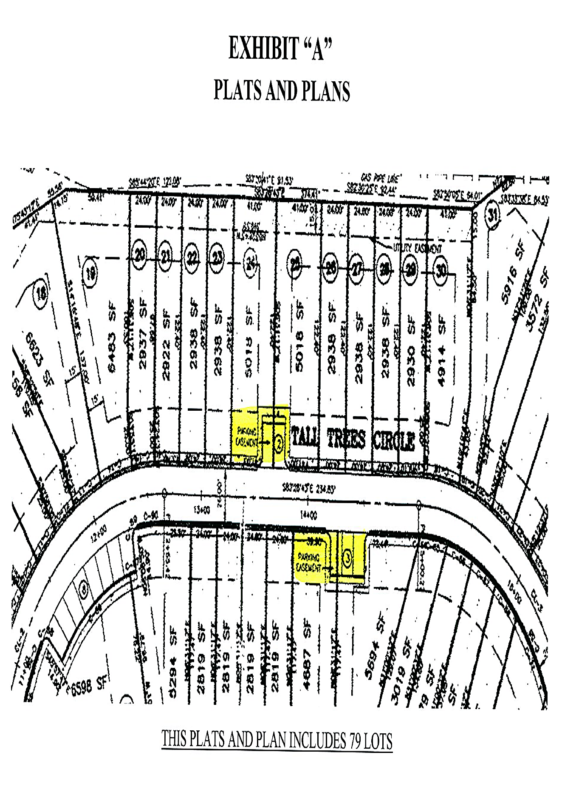
Reidenbach & Associates, LLC

Slide 8
General Development Documents
DECLARATION: Is the basic document which subjects the property to the applicable statute and form of ownership. A common interest ownership (CIO) community is created by filing the declaration and compliance with the applicable provisions of the Acts.
Description of Units:
The UCA Defines a Condominium as:
Real estate, portions of which are designated for separate ownership and the remainder of which is designated for common ownership solely by the owners of those portions. Real estate is not a condominium unless the undivided interests in the common elements are vested in the unit owners.
Common elements:
All portions of a condominium other than the units .
Limited common elements:
A portion of the common elements allocated by or pursuant to the declaration or by operation of section 3202(2) or (4) for the exclusive use of one or more but fewer than all of the units.
[Please see Exhibit “B” for Discussion]
Reidenbach & Associates, LLC

Slide 9
Description of Units
The UPCA Defines a Planned Community as:
Real estate with respect to which a person, by virtue of ownership of an interest in any portion of the real estate, is or may become obligated by covenant, easement or agreement imposed on the owner’s interest to pay any amount for real property taxes, insurance, maintenance, repair, improvement, management, administration or regulation of any part of the real estate other than the portion or interest owned solely by the person. The term excludes a cooperative and a condominium, but a condominium or cooperative may be part of a planned community.
Common elements - in planned communities are referred to as “common facilities or controlled facilities”.
A common facility - any real estate within a planned community which is owned by the association or leased to the association. The term does not include a unit.
A controlled facility - any real estate within a planned community, whether or not a part of a unit, that is not a common facility but is maintained, improved, repaired, replaced, regulated, managed, insured or controlled by the association.
[Please see Exhibit “C” for an example]
Incorporate Or Not to Incorporate
The Association is organized as a profit or nonprofit corporation or as an unincorporated association. (UCA §3301 or UPCA §5301)
Reidenbach & Associates, LLC

Slide 10
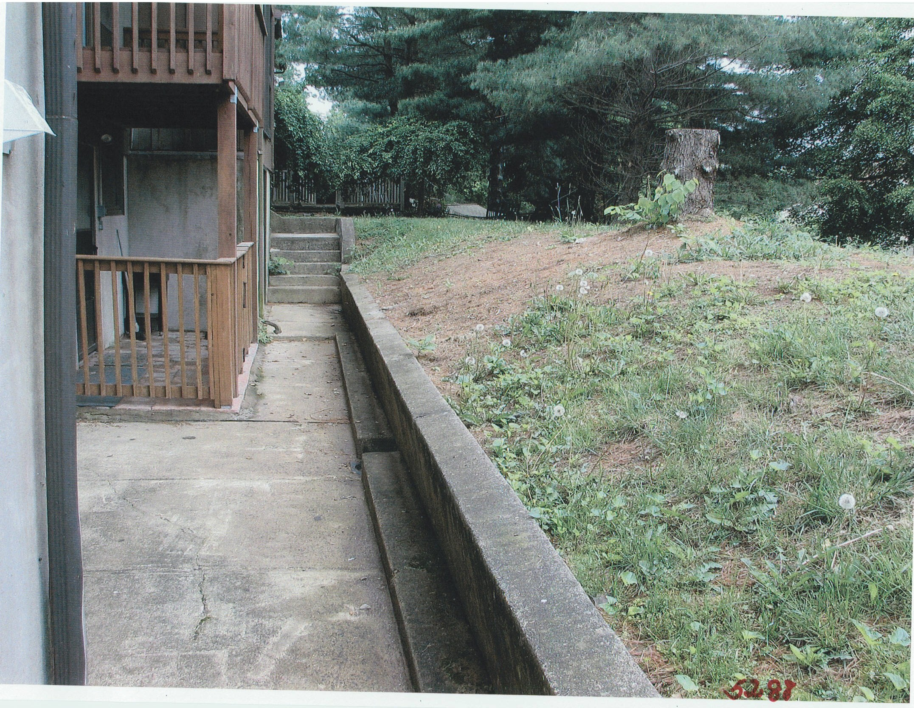

Slide 11
Public Offering Statement
Public offering statement is designed as a consumer protection document intended to help a purchaser understand the nature of the bundle of rights and obligations he will have upon the ownership of a unit in a condominium or planned community.
Exception: A community with less that 12 units which is not a flexible community and which is not potentially part of a larger community or group of communities. See §3401(B) and §5401(B) and §3402(B) and §5402(B)
(1) a gratuitous transfer of a unit;
(2) a disposition pursuant to court order;
(3) a disposition by a government or governmental agency;
(4) a disposition by foreclosure or deed in lieu of foreclosure;
(5) a disposition of a unit situated wholly outside this Commonwealth pursuant to a contract executed wholly outside this Commonwealth; or
(6) a transfer to which section 5407 (relating to resale of units) applies.
Reidenbach & Associates, LLC

Slide 12
Public Offering Statement
Provide a comprehensive list of what must be included in the Public Offering Statement under the (UCA §3402 or UPCA §5402).
Must Include In the Public Offering Statement:
Declaration, Bylaws, Rules and Regulations
Disclosure of “unusual and material circumstances, features and characteristics”.
Agreement of Sale.
Copies of Contracts or Leases to be executed by the purchaser.
Statement of the budget’s material assumptions, including those concerning occupancy and inflation factors.
Statement of the amount, or that there is no amount, included in the budget as a reserve for repairs and replacement.
Statement of the amount, or that there is no amount, for reserves for anticipated material capital expenditures or any other reserves.
To the extent to which financial arrangements have been provided for
completion of all improvements labeled "MUST BE BUILT“. (UCA §3414 or
UPCA §5414)
Declarant must label all improvements which may be made in the community as either “MUST BE BUILT” or “Need NOT BE BUILT”
Reidenbach & Associates, LLC

Slide 13
Public Offer Statement Additional Provisions to Consider
Both acts provide identical exemptions for the requirement of providing a public offering statement. (see, UCA § 3401(B) and UPCA § 5401(B)
Unlike the UCA the UPCA includes Section 5411(f), Disclaimer of implied warranties.
Description of liens, defects or encumbrances on or affecting title to the condominium or planned community.
Communities having a conversion require a Condition Assessment Report including disclosure of hazardous substances. See §3404 and §5404.
Public offering statement must be provided to a potential purchaser by the Declarant before the purchaser enters into an agreement of sale, otherwise, the agreement of sale is revocable for a period of fifteen (15) days (for condominiums) or seven (7) days (for planned communities) from the date the purchaser does receive the public offering statement.
Reidenbach & Associates, LLC

Slide 14
Declaration
The Declaration is the primary document for governance of a Condominium and a Planned Community.
Noted Requirements of the Declaration
Mandatory provisions regarding the contents of the Declaration can be found under UCA § 3205 or UPCA §5205.
Contents of Declaration regarding Flexible Condominiums or Planned Communities (Additional Real Estate, Convertible Real Estate and Withdrawable Real Estate) can be found under the (UCA §3206 or UPCA §5206).
Special Declarant Rights.
Declarant’s Ability to Continue to Build, Sell, Market, etc. After Five or Seven Years.
Period of Declarant Control – Seven (7) years in the case of a flexible community containing convertible real estate or to which additional real estate may be added or five (5) years in the case of any other planned community.
Reidenbach & Associates, LLC

Slide 15
PREPARATION OF DOCUMENTS
In Preparing the Declaration Consider the Following: See 3211, 3212, 5211 and 5212 and §3206 and §5206 for Contents of Declaration for Flexible Condominiums or Planned Communities.
A. Flexible Community:
An explicit reservation in the Declaration of any options to create units, limited common elements, or both, within convertible real estate, or to add additional real estate to or withdraw withdrawable real estate from the community.
i. Convertible Real Estate: Example - “To Convert all or any portion of the Convertible Real Estate to Garage Units and Garage Limited Common Elements from time to time in compliance with §3211 of the Act without the consist of any Unit Owner or mortgagee”.
ii. Additional Real Estate: Example – “Declarant hereby explicitly reserves an option, until the seventh (7th) anniversary of there recording of this Declaration, to add Additional Real Estate to the Condominium from time to time in compliance with §3211 of the Act without the consent of any Unit Owner or mortgagee”.
iii. Withdrawable Real Estate: Example – “To withdraw Withdrawable Real Estate from the Condominium from time to time in compliance with §3212 of the Act without the consent of any Unit Owner or mortgagee”.
Reidenbach & Associates, LLC

Slide 16
Special Declarant Rights
Rights reserved of the benefit of the Declarant - §3103 and §5103
Protect the rights and property value of the Declarant
Divide a Unit into 2 or more units.
Maintain office(s) signs and model.
Make the community subject to a Master Association.
Appoint or remove and an officer or a board member during the period of
Declarant control.
Use Easements through the common facilities or controlled facilities for the
purpose of making improvements within the planned community.
Special Declarant Rights are a commodity that can be sold, divided or shared.
[See Exhibit “ C &D”]

Slide 17
Provisions Applicable to a Condominium
The sum of the undivided interests in the common elements and common expense liabilities allocated at any time to all the units must equal one (if stated as a fraction) or 100% (if stated as percentages). (UCA §3208(e))
Restrictions on use, occupancy and alienation of units, if any.
List of recorded easements and licenses.
Special Declarant Rights - Master Association, merger, consolidation.
Description of limited common elements and assessment of limited common expenses.
Description of common elements which may become limited common elements at a later date.
Reidenbach & Associates, LLC

Slide 18
Provisions Applicable to a Planned Community
The sum of common expense liability allocated at any time to all the units must equal one (if stated as a fraction) or 100% (if stated as percentages). (UPCA §5208(e))
Restrictions on use, occupancy and alienation of units and any easement or license rights that unit owners are to have with respect to the use or enjoyment of any of the common elements that are not contained in other documents which are recorded, if any.
List of recorded easements and licenses.
If declarant wishes to retain the right to subject any portion of the planned community to an easement or license in favor of any real estate not included in the planned community, or
in favor of any person who is not an owner or occupant of a unit in the planned community, then an explicit reservation and description of such right and a description of the effects on the association and the unit owners of the easement or license, including any impact on the budget. (UPCA §5205(15))
If a declarant wishes to retain the right to designate as a common facility in any portion of a planned community or any improvement or facility then existing or contemplated for a planned community, then the declaration must also include that which is set forth in UPCA §5205(16).
Reidenbach & Associates, LLC

Slide 19
Amendment(s) to the Declaration
Unit owner approval is not required for exercise of Special Declarant Rights including right to add Additional Real Estate, withdraw Withdrawable Real Estate or convert Convertible Real Estate.
Unless declaration provides for a greater percentage, the declaration can only be amended by vote or agreement of unit owners of units to which at least 67% of the votes in the association are allocated.
Amendments must be recorded.
Corrective amendments do not require the approval of the unit owners.
[See Exhibits “D, F,G”]
Reidenbach & Associates, LLC

Slide 20
Bylaws
Bylaws set forth matters related to the internal operations of the association and various housekeeping matters with respect to the condominium
The requirements of Bylaws for planned communities under the UPCA are the same as for condominiums under the UCA. See sections 3306, 3308 and 3309 of the UCA and Sections 5306, 5308 and 5309 of the UPCA.
Noted Mandatory provisions
Number of members of the executive board and the titles of the officers.
Election by the executive board of at least a president, treasurer and secretary.
The qualifications, powers and duties, terms of office and manner of electing and removing executive board members and officers and filling vacancies.
Delegation of powers to manager or other third-party agent.
Identification of officer(s) with authority to prepare, execute, certify and record amendments to the declaration on behalf of the association.
Method for amending bylaws.
Reidenbach & Associates, LLC

Slide 21
Bylaws
Meetings
Bylaws must provide for meetings of the Association to be held at least once per year and must provide for special meetings. (See §3308 and §5308)
Quorums
Unless otherwise provided in the bylaws, a quorum is deemed present if persons entitled to cast 20% of the votes which may be cast for election of the executive board are present in person or by proxy at the beginning of the meeting. Quorum requirement cannot be less than 10%. (See §3309 and §5309)
Upkeep
Unless otherwise provided in the declaration, the association is responsible for the maintenance, repair and replacement of the common elements, and each unit owner is responsible for maintenance repair and replacement of his unit. (See §3307 and §5307)
Voting and Proxies
See §3310 and §5310
Reidenbach & Associates, LLC

Slide 22
Powers of the Association
See §3302 and §5302
Adopt and amend bylaws, rules and regulations, budgets and collect assessments
Institute, defend or intervene in litigation.
Enter into contracts and incur liabilities.
Regulate the use, maintenance, repair, replacement and modification of common elements.
Grant easements, leases, licenses and concessions through or over the common elements.
Impose and receive any payments, fees or charges for the use, rental or operation of the common elements.
Impose charges for late payment of assessments.
Impose reasonable charges for preparation and recordation of amendments to the declaration, 3407 resale certifications or statements of unpaid assessments.
Impose a capital improvement fee, but no other fees, on the resale or transfer of units.
Provide for the indemnification of its officers and executive board and maintain directors’ and officers’ liability insurance.
Assign its right to future income, including the right to receive the payments made on account of common expense assessments (except reserve funds).
Exercise all other powers that may be exercised by legal entities of the same type as the association.
Reidenbach & Associates, LLC

Slide 23
Executive Board Members and Officers
Declaration, bylaws, UCA and the UPCA dictate how the executive board shall act on behalf of the association.
Executive board members and officers have a fiduciary relationship with the association and must perform their duties in good faith in a manner they reasonably believe to be in the best interests of the association.
Executive board members will have no liability in exercising the powers given to them so long as:
they are exercised in good faith,
in the best interest of the association and under the proscribed manner, and
care as set forth in the UCA and the UPCA, declaration and bylaws.
Cannot act on behalf of the association to amend declaration, terminate the condominium, elect members of the executive board or determine the qualifications, powers and duties or terms of office of executive board members.
(See UCA §3303 and UPCA §5303)
Reidenbach & Associates, LLC

Slide 24
Rules and Regulations
Last in the level of hierarchy, rules and regulations clarify and provide additional details to ambiguous language in any of the above governing documents.
Topics typically covered in the Rules and Regulations:
Special fees
Pets
Collection policies and procedures for delinquent Unit Owner accounts
Exterior improvement restrictions and role of an architectural control committee.
Parking
Alterations
Playground, swimming pool and club house controls
Obstructing common areas
Trash and Garbage
Move-ins and move-outs
Reidenbach & Associates, LLC

Slide 25
Before Beginning to Draft
Meet with the client and flesh out in person if possible (or on the phone if not) the goals of the condo project.
Commercial v. Residential
There are different forms and language needed for each situation. If it is a mostly residential building with some commercial space, you need to account for the percentage interests, sharing of common elements and limited common elements and how utilities and other costs will be shared and divided.
For existing condos
Was the document drafted well and according the Act? Does it make sense? Are there conflicting definitions? Do the declaration and bylaws line up well or have conflicting provisions.
Board
What type of board are you working with? A strong, informed, detail-oriented board or one that is a proxy for developer and that does not have the community’s best interest at heart?
Major issue(s)
What is driving this project? Does the association have trouble collecting assessments? Is someone trying to create a new condo?
Reidenbach & Associates, LLC

Slide 26
Starting the document; Choosing the Right Form
There are many things to consider when starting to draft for a new condo or amending an existing declaration.
Defined Terms
There are terms in your form that are statutorily-mandated (e.g., common elements, common expenses, unit, association) but you can add those non-statutory terms that are helpful to describe things like party walls, percentage interest or certain limited common elements.
Amendments
If doing an amendment, do a title search to see if there are prior amendments and how they may have altered the original recorded declaration.
Declarant rights
For existing condos being amended, is the developer still in the picture and if not, has been a turnover or transition, was it done correctly including deeding of the common elements to the association?
How to Allocate Percentage Interests
It is usually based on the size of the unit (i.e., square footage), which is the recommended method, but can be done in other ways if desired.
Reidenbach & Associates, LLC

Slide 27
Communication With Client During The Drafting Process
Communication is key!
You want to be sure you are not drafting for yourself or that it becomes a law school project.
The Board likely has a budget and the expectation that it will cost less and take less time than the lawyers know it will.
Manage expectations and keep in touch with the client frequently and share problems that arise (e.g., with defects discovered in title or that changes requested by the Board will add to the cost).
Remember who is your client.
Reidenbach & Associates, LLC

Slide 28
Key items in Governing Documents to Consider or Include
Powers of the board
Assessments/Budget/Reserves/Audit powers
Insurance requirements
Leasing restrictions
Plats and Plans
Bylaws and Rules and Regulations
Governing documents, while not recorded, need to be addressed and should be drafted concurrently with the declaration. They need to line up and be consistent with the declaration and not conflict with or override its provisions; they should all work in tandem. Rules and regulations are a great place for leasing restrictions or architectural standards as they can usually be revised by the Board without going through the more burdensome amendment process.
Reidenbach & Associates, LLC

Slide 29
Ensuring Age Restrictions Are Legal
The Housing for Older Persons Act of 1995 (HOPA) amends Title VIII of the Civil Rights Act of 1968 (Fair Housing Act).
This law states that it is legal for communities to market themselves as “55+”or “age-restricted” provided they maintain that 80 percent of the occupied units are occupied by at least one person who is 55 years of age or older. Assuming, however, the number of people age 55+ in a given community falls below the 80 percent threshold, they could lose their age-restricted status.
Most 55+ age-restricted active adult communities will place an age-minimum on the residents.
In most active adult communities, no one under the age of 19 may reside in the community. However, at a community’s discretion, the age-minimum may be higher or lower.
Reidenbach & Associates, LLC

Slide 30
Transfer of Special Declarant Rights
The document transferring special declarant rights must specify which rights are being transferred, and whether any are being retained by the original declarant, or being shared.
The transferee declarant must execute the document of conveyance
A transferor is not relieved of its liabilities or warranties for its prior acts and, so long as it is unaffiliated with the transferee, it does not assume the risk for the transferee’s acts
Special rules apply for units or additional real estate purchased at a foreclosure sale or via bankruptcy, and for lenders in possession.
A purchaser via bankruptcy or foreclosure may request and receive all special
declarant rights of the original declarant, or only the rights to sell and market units
Rights of Purchaser in Foreclosure, etc. Proceedings
The declarant ceases to have any special declarant rights.
The period of declarant control terminates unless the judgment or instrument conveying title provides for transfer of all special declarant rights held by that declarant to a successor declarant.
[See Exhibit “H” ]
Reidenbach & Associates, LLC

Slide 31
Liabilities and Obligations of Successors
A successor to any special declarant right who is/isn’t an affiliate of declarant is subject to all obligations and liabilities imposed on the transferor.
Until transferring all special declarant rights to any person acquiring title to any unit owned by the successor or until recording an instrument permitting exercise of all those rights.
So long as a successor declarant may not exercise special declarant rights he is not subject to any liability or obligation as a declarant other than the successor’s acts or omissions.
Liabilities and Obligations of Transferees
Declarant appointees to the Executive Board stand in a fiduciary relationship to the members of the association.
Reidenbach & Associates, LLC

Slide 32
Transfer to Home Owner Control
Within (180) days after 75% of the condominium units are conveyed (UCA § 3303(c)) and within (60) days after 75% of planned community units are conveyed (UPCA § 5303(b)(2)),
or
such earlier date a declarant may select, a declarant must transfer control of the association to the owners, through an election process.
The statutes require a sooner transition of two (2) years after all declarants in the community association regime cease to offer units for sale in the ordinary course of business.
At the transition date, the association may terminate contacts between the association and the declarant or declarant-affiliated companies.
Reidenbach & Associates, LLC

